Slide 1

Customer Shopping Behavior Analysis
Uncovering patterns in retail data to drive better business decisions.

Slide 2
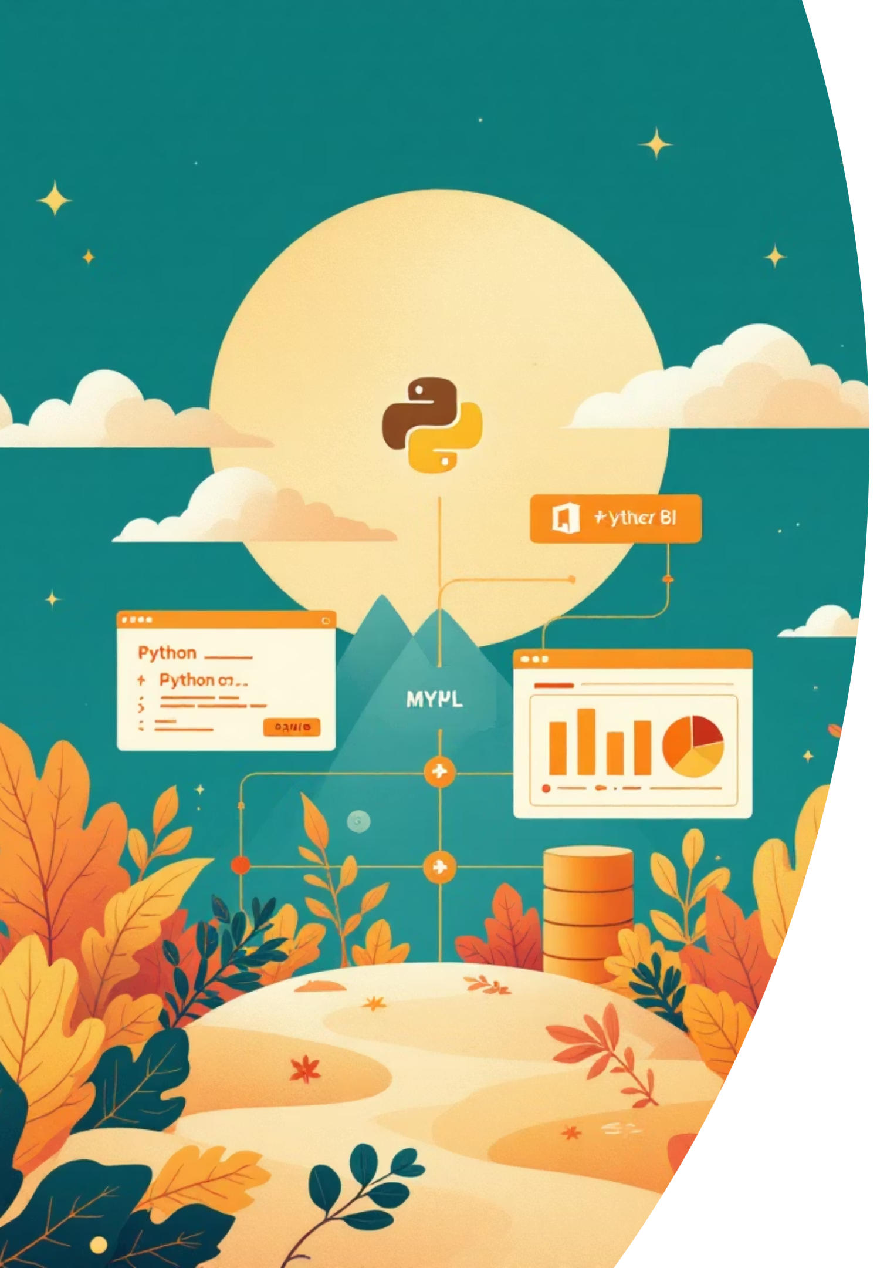
Project Overview: End-to-End Data Analytics
01
02
Data Cleaning & Transformation
Data Storage & Querying
Using Python in Jupyter Notebook.
Leveraging MySQL for efficient management.
03
Data Visualization & Insights
Generating actionable insights with Power BI.

Slide 3

Business Problem: Understanding Customer Interactions
A retail company needs deeper insights into customer product and service interactions.
Key Challenges
Identifying high-value and loyal customers.
Impact of discounts and subscriptions on revenue.
Best performing products and categories.
Demographic influence on spending (age, gender).
Core Question
How can shopping data optimize marketing, retention, and product strategies?

Slide 4
Project Objectives
1
Clean & Prepare Data
Using Python for customer shopping data.
2
Store Structured Data
In MySQL for efficient querying.
3
Perform SQL Analysis
To answer real business questions.
4
Build Interactive Dashboard
Visualize insights with Power BI.
5
Provide Recommendations
Data-driven business strategies.

Slide 5

Dataset Description & Quality
Total Records: 3,900 purchases
Total Columns: 18
Key Fields: Customer demographics (Age, Gender, Location), Purchase details (Item, Category, Amount, Season), Shopping behavior (Discount, Subscription, Review Rating), Transaction behavior (Previous Purchases, Frequency, Shipping Type).
Data Quality Notes
Missing values in Review Rating column.
Data types and column naming required standardization.

Slide 6

Data Preparation & Cleaning (Python)
Data Loading
Imported dataset using pandas.
Initial Exploration
Used .info() and .describe() for structure and distributions.
Handling Missing Values
Filled missing review ratings with median per product category.
Column Standardization
Converted column names to snake_case.
Feature Engineering
Created 'age_group' and other derived fields.
Data Export
Cleaned data saved for database loading.

Slide 7
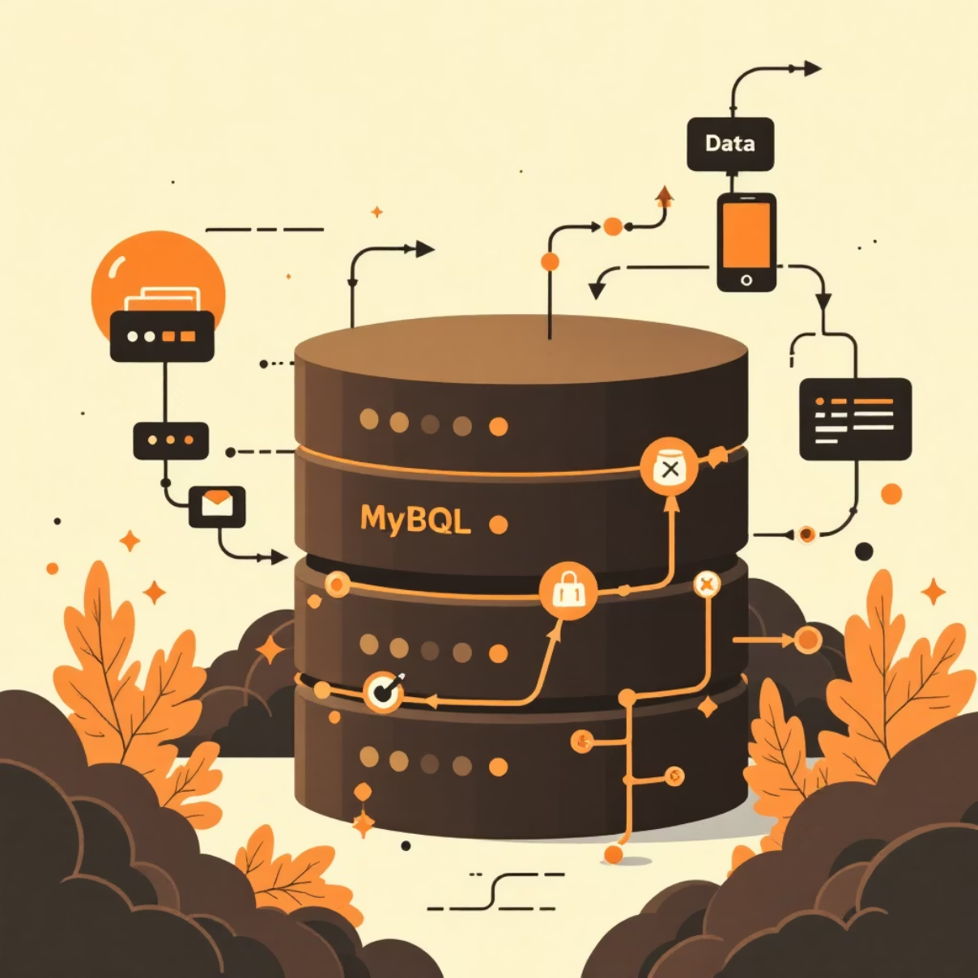
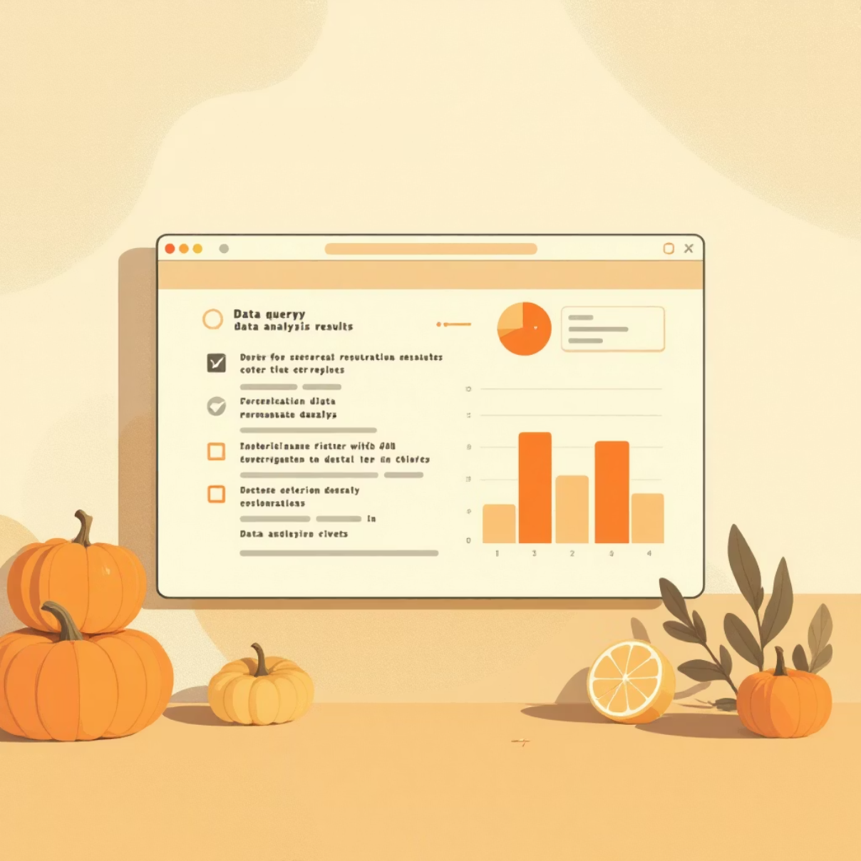
Database Integration (MySQL) & SQL Analysis
MySQL Integration
Key SQL Analysis Questions
Created database and defined tables.
Revenue by Gender & Age Group.
Loaded cleaned dataset into MySQL.
High Spending Discount Users.
Verified data insertion with SQL queries.
Top Rated Products & Discount Dependent Products.
Subscribers vs. Non-Subscribers spending.
Customer Segmentation & Repeat Buyers.

Slide 8
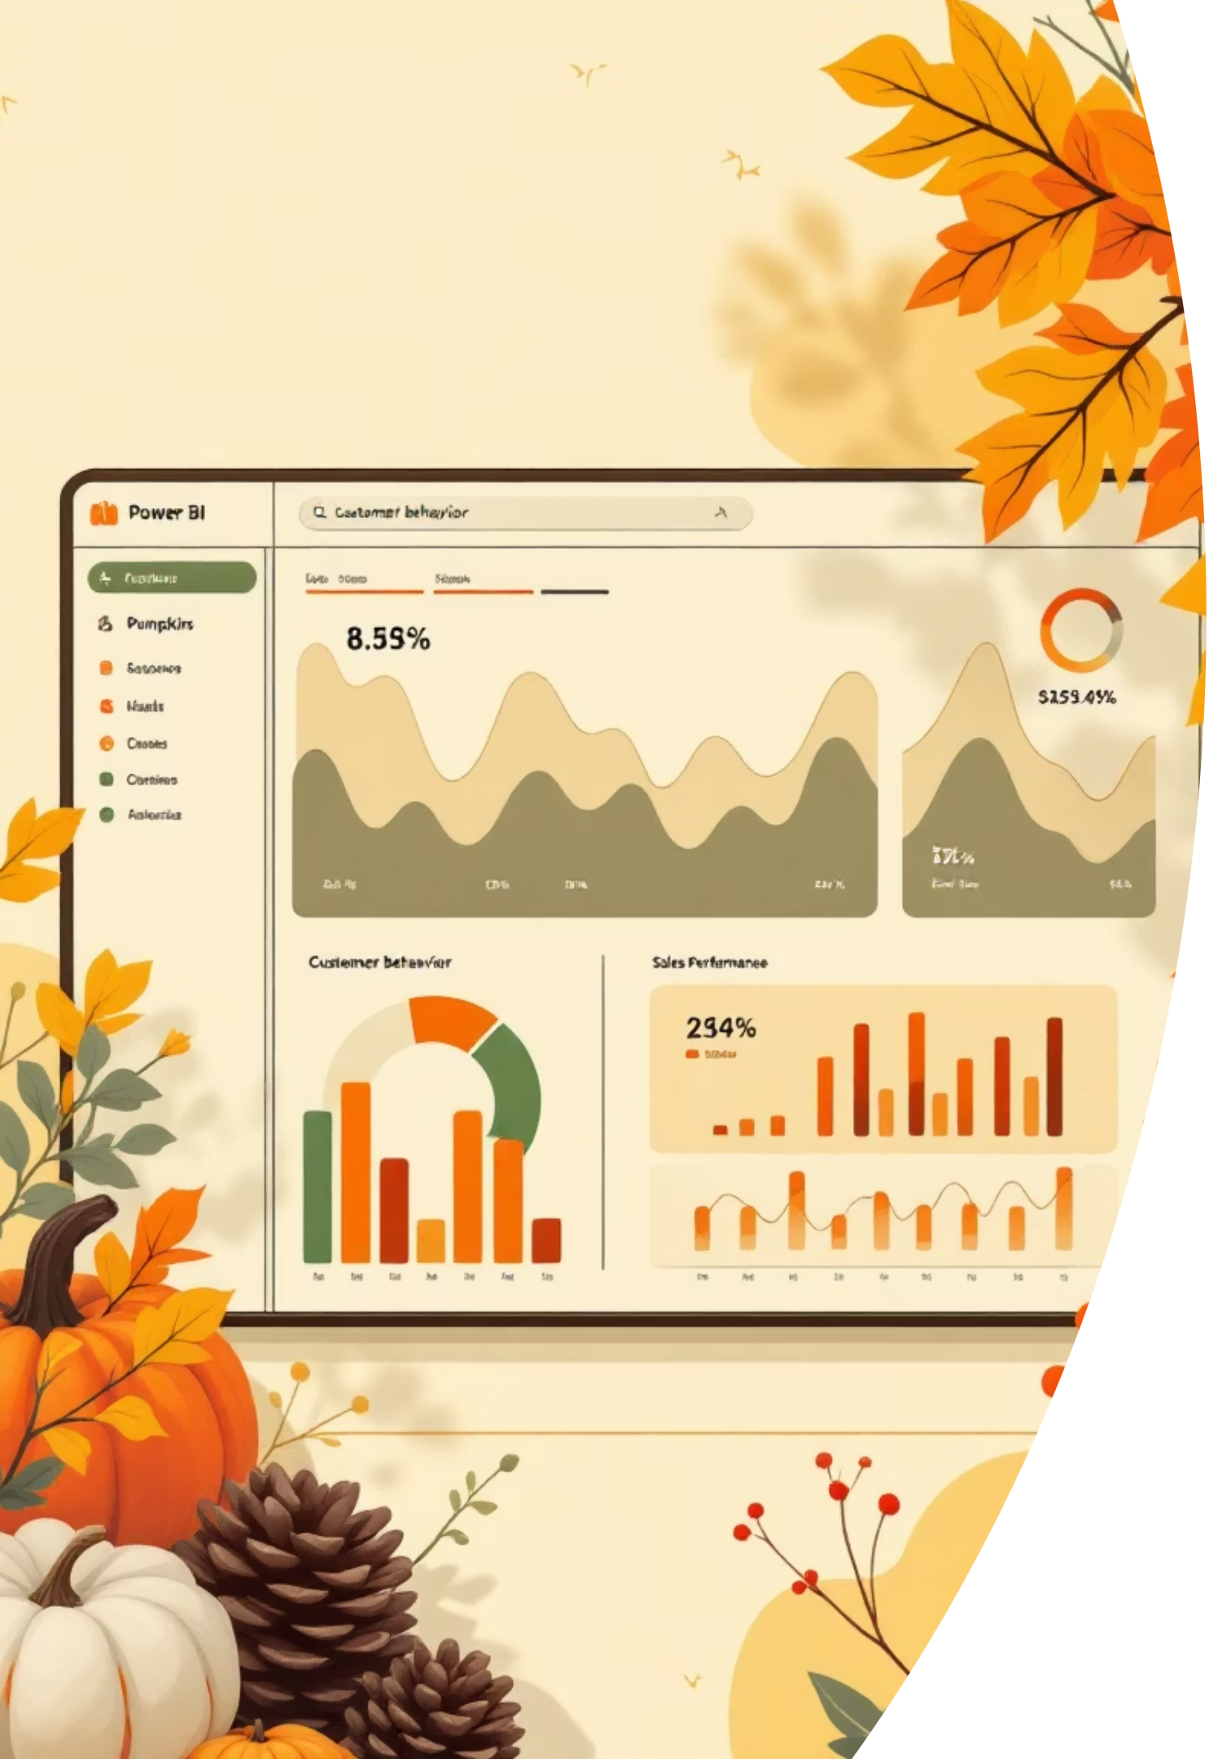
Power BI Dashboard: Customer Behavior
Interactive dashboard for intuitive exploration of customer shopping patterns.
3.9K
3.75
$59.76
Customers
Avg. Review
Avg. Purchase
Total unique customers.
Overall satisfaction level.
Average spending per transaction.

Slide 9
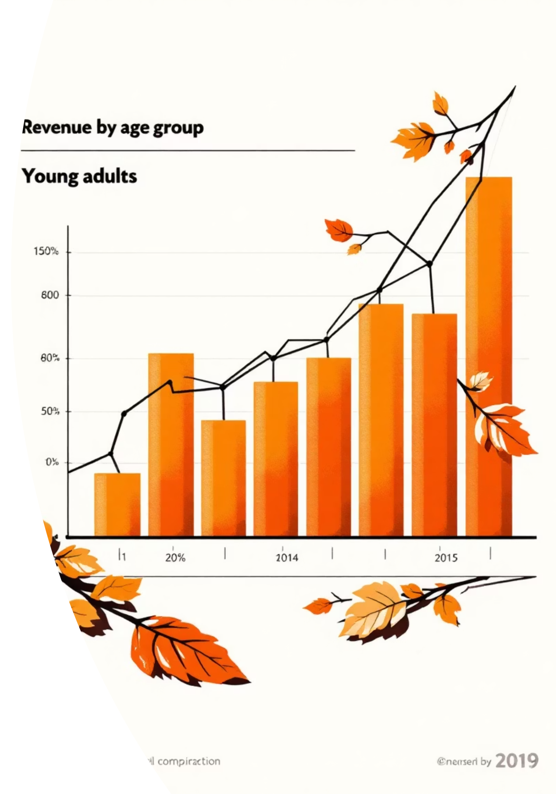
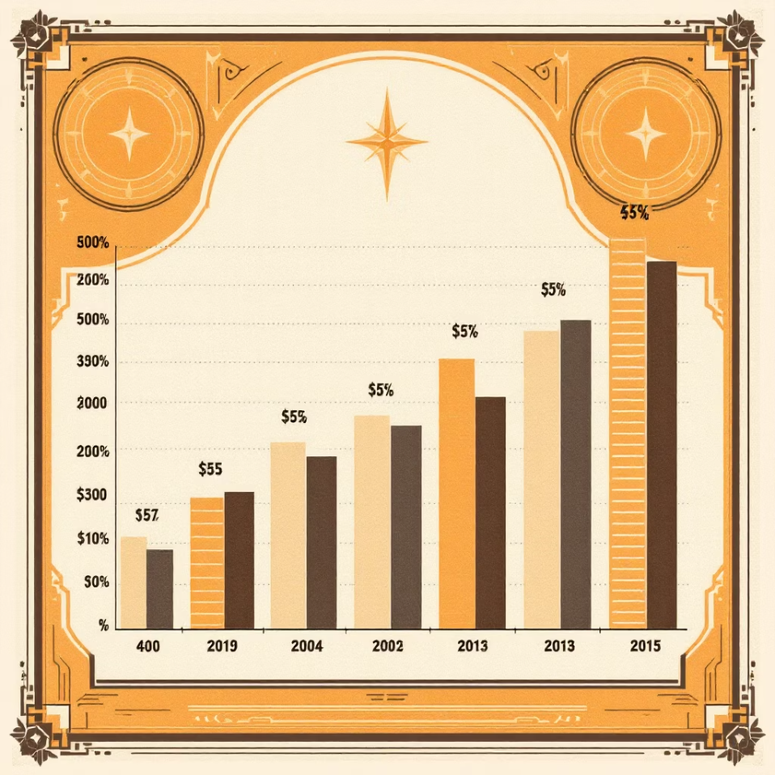
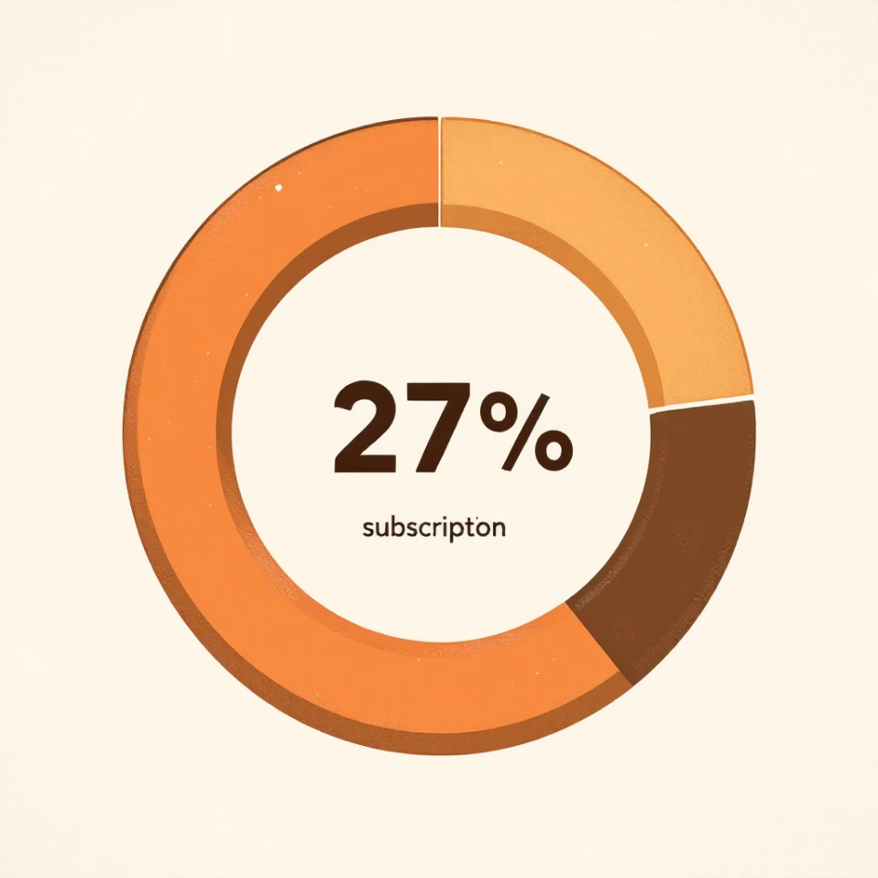
Dashboard Insights: Key Findings
Subscription Status
Category Performance
27% Subscribers, 73% Non-Subscribers. Opportunity for conversion.
Clothing generates highest revenue and sales. Accessories follow closely.
Young Adults are key revenue drivers, with Middle-aged customers also strong.

Slide 10
Business Recommendations & Conclusion
1
Improve Subscription Offers
Targeted promotions to convert non-subscribers.
2
Strengthen Loyalty Programs
Reward repeat customers for long-term engagement.
3
Optimize Discount Strategies
Boost sales without unnecessary profit margin reduction.
4
Focus on High-Performing Categories
Allocate more marketing and inventory resources.
5
Target High-Value Segments
Design campaigns for top revenue-generating age groups.
This project provides a strong foundation for data-driven decision-making, improving customer engagement and business performance.

